Slide 1

Soil : Natural Resource
Presented by:
Dr. Vinayak V. Pathak
Assistant Professor
Department of Chemistry
Manav Rachna University Faridabad (Haryana) India

Slide 2
Contents
Soil : Definition and classification
Soil profile
Soil organic matter
Cation exchange capacity
Method of sampling
Physicochemical characterization

Slide 3
What is Soil?
Soil is a material composed of five ingredients — minerals, soil organic matter, living organisms, gas, and water.
The term soil is sometimes applied to the entire surficial earthy layer which is inhabited by plant roots and its limits is the depth at which roots are found (Sibirtsev, 1900).
According to the Soil survey Staff (2010) “ Soil is a natural body comprised of solids, liquid, gases that occurs on the land surface, occupies space that is characterized by horizons or its ability to support a rooted plant in its natural environment”.

Slide 4
Classification of soil
Commonly based on the grain size and soil consistency, following classification system exists:
Unified Soil classification system (ASTM D3282-09)
Indian standard soil classification system (ISSCS)

Slide 5
Unified Soil classification system (ASTM D3282-09)
Two major categories:
Coarse-grained soil: that are gravely and sandy nature with less than 50% passing through the No. 200 sieves.
Fine-grained soil: with 50% or more passing through the No. 200 sieves.

Slide 6
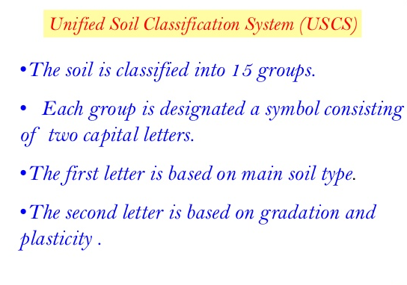

Slide 7
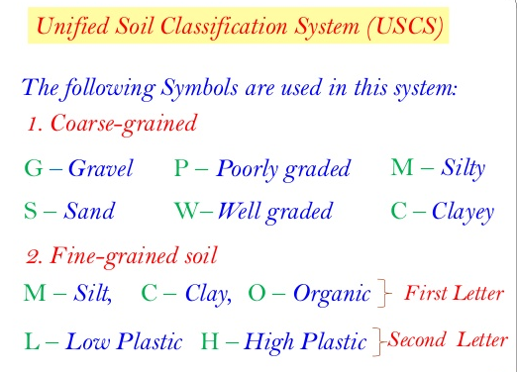

Slide 8
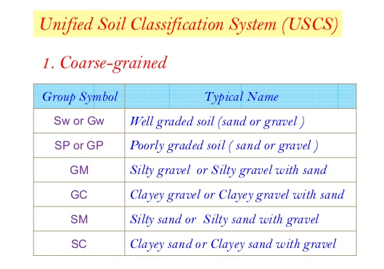

Slide 9
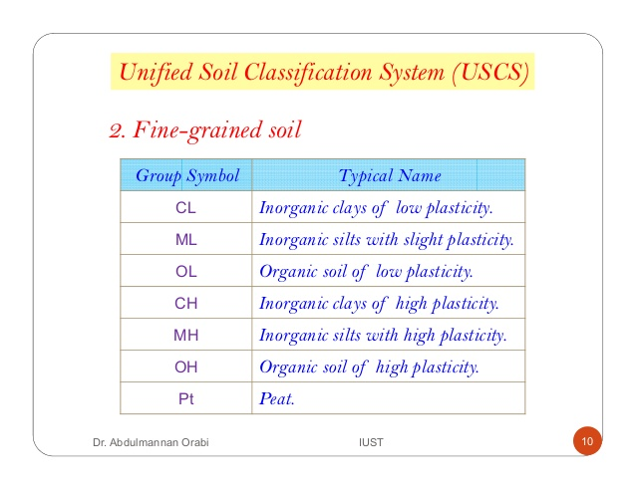

Slide 10
Indian standard soil classification system (ISSCS) IS 1490-1970
Soil shall be broadly divided into three divisions:
Coarse-grained soil
Fine Grained soil
Highly organic soil
More than half the total materials by weight is larger than the 75 micron IS sieves.
More than half of the material by weight is smaller than the 75 micron IS Sieves
Contains large percentage of fibrous organic material such as peat and particles of decomposed vegetation.

Slide 11
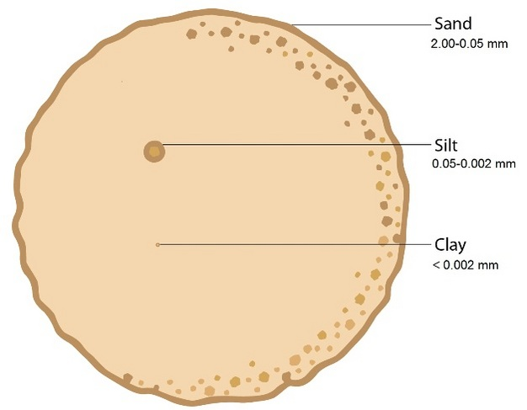

Slide 12
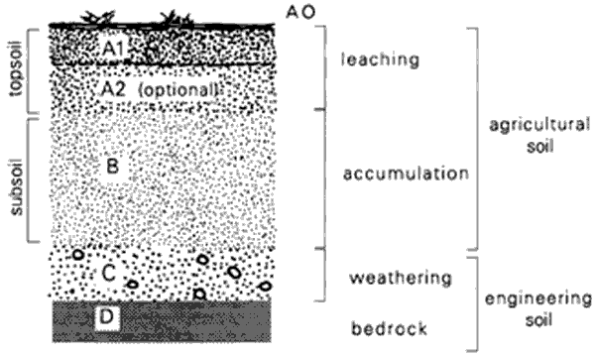
Soil Profile
A soil profile is a vertical section of soil A soil profile is divided into layers called horizons.
The main soil horizons are A, B, C and D.

Slide 13
A and B horizons are important for the plant growth.
A horizon is also termed as Top soil.
The B horizon is where clays and materials washed down from the A horizon accumulate. This is sometimes called subsoil.
The C Horizon consists of weathering rock.
The D horizon is bedrock. This is rock which has weathered to produce the soil

Slide 14
Soil Organic matter
Based on the organic matter content, soils are characterized as Mineral or Organic.
Mineral soil: it involves most of the cultivated land and may contain from a trace to 30% organic matter.
Organic Soil: Rich in organic matter and contain more than 30percent of organic matter.
Soil organic materials are produced originally by living organisms through the decomposition process.

Slide 15
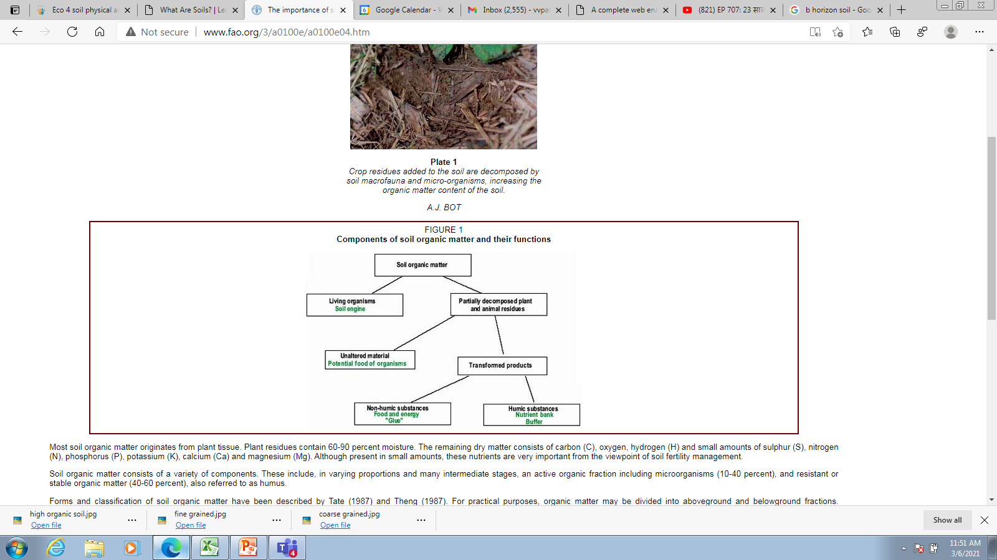

Slide 16
Soil organic matter: key points
Soil organic matter is classified as above ground and below ground organic matter.
Aboveground organic matter is composed of plant and animal residues, while belowgound consist of living soil fauna and micro flora, partially decomposed plant and animal residue and humic substances.
Soil organic matter act as a store house for plant nutrients.
The stable organic fraction (humus) adsorbs and holds nutrients in a plant-available form.
The resistant or stable fraction of soil organic matter contributes mainly to the nutrient holding capacity.

Slide 17
Cation exchange capacity
Cation exchange capacity is a measure of how many cations can be retained on soil particle surface.
Negative charges on the surface of soil particles bind the positively charged atom molecules, but allow these to exchange with other positively charged particles.
CEC influences the chemistry of soil and is used as a measure of soil fertility as it indicates the capacity of soil to retain several nutrients such as K⁺ , NH₄ etc.
The binding is relatively weak, and a cation can easily be displaced from the surface by other cations from the surrounding solution.

Slide 18
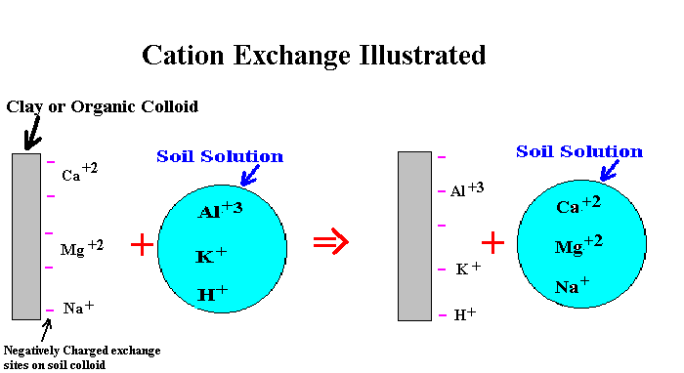

Slide 19
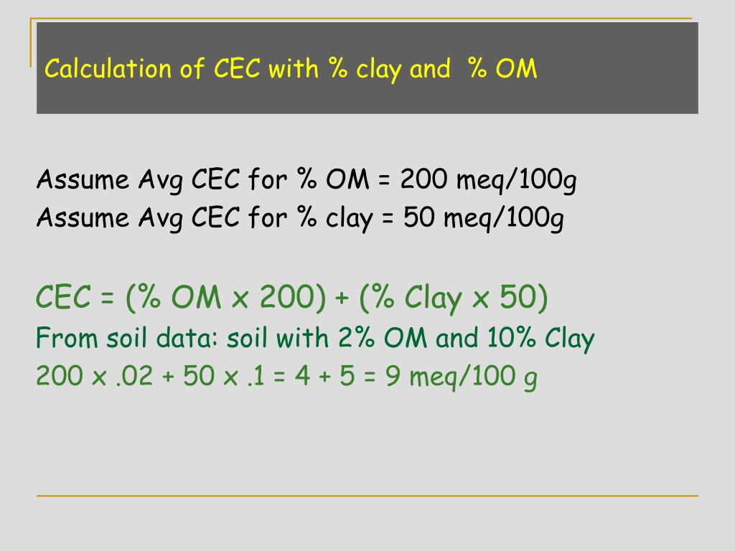

Slide 20
Methods of soil sampling
Disturbed sampling: : The structure of the soil is disturbed to the considerable degree by the action of the boring tools or the excavation equipment's.
Undisturbed sampling: It retains as closely as practicable the true insitu structure and water content of the soil. For undisturbed sample the stress changes can not be avoided.
Zone based sampling: In zone-based strategies, the goal is to collect samples that represent the average soil within each zone. Zones are typically developed based on unique soil types or from patterns in yield maps. The key aspect of each zone is that zones represent areas of homogeneous or uniform soil conditions.
Grid sampling: In a grid system, soil samples are taken at locations spaced in a uniform pattern. Typical grid sizes range from 1 to 5 acres, with smaller grids (i.e., 2.5 acres or less) providing the best results.

Slide 21
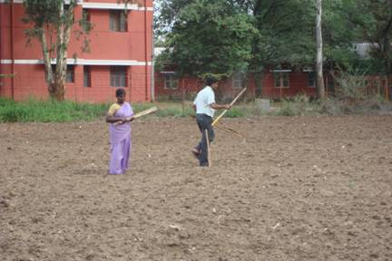
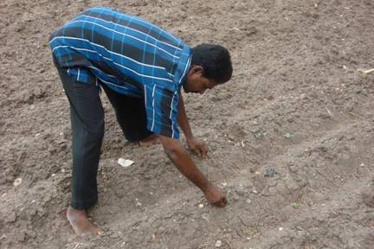
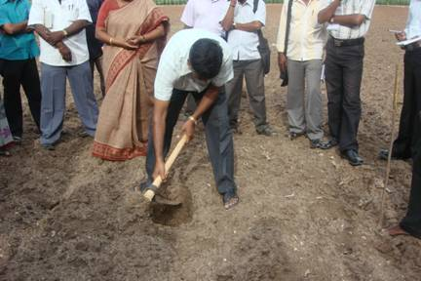
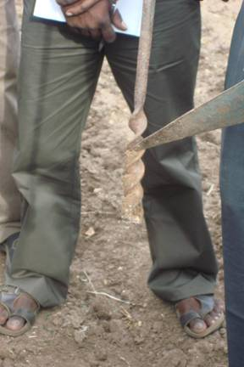
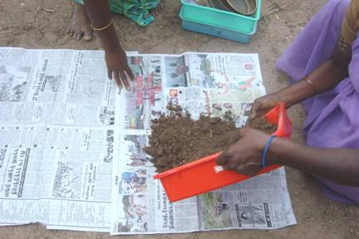
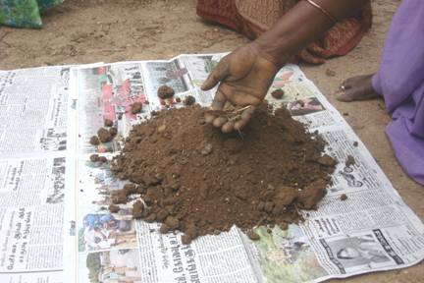
Selecting sampling spot
Remove the surface litter at the sampling spot
Make a ‘V’ shaped cut to a depth of 15
Collect soils using khupri
Mix the samples thoroughly
Remove foreign materials

Slide 22
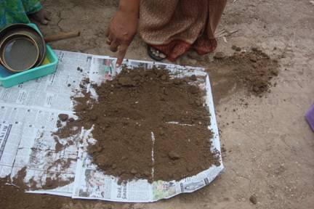
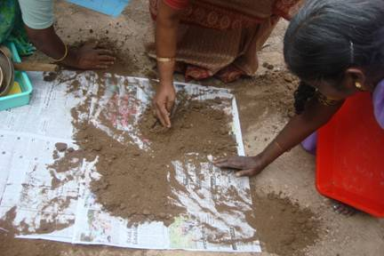
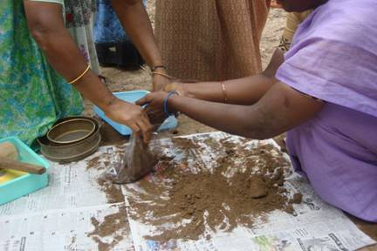
Quartering is done by dividing the thoroughly mixed sample into four equal parts
Two opposite quarters are discarded and the remaining is mixed
Collect the sample in a clean cloth or polythene bag

Slide 23
Physicochemical characterization of soil
Soil Texture
Soil colour
Hydraulic Conductivity
Porosity
Soil pH
Conductivity
Total organic carbon
Total Nitrogen
Total Phosphorus
Water holding capacity
C/N ratio

Slide 24
Soil erosion
Soil erosion is a naturally occurring process that affects almost all landforms.
Half of the top soil on the planet has been lost in the last 150 years.
The effects of soil erosion go beyond the loss of fertile soil, it has led to increased pollution and sedimentation in to the streams.
Water and wind erosion are the two primary cause for land degradation.

Slide 25
Desertification
Desertification refers to the process of formation of desert. It may be due to the degradation of dryland ecosystem by climatic variations and human activities.
Desertification occurs as a result of long term failure to balance the human demand for ecosystem services. The pressure is increasing on dryland ecosystems for providing food, fuel, forage, building materials etc.
Approximately 10 to 20% dryland has been already degraded, which are more prone to desertification.
About 30% of the land in India is degraded.

Slide 26
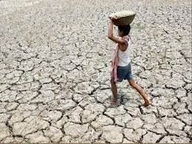
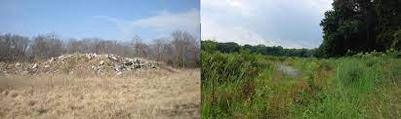

Slide 27


